Slide 1

Problemsolving Tools – Using issue trees
www.antler.co

Slide 2
”Fall in love with the problem, not the solution”

Slide 3
Be creative in a structured way
1. Define the area of focus
2. Ideate (long list):
What are the problems/pain-points within the area of focus?
Who is it a problem/pain-point for?
Notes:
Traction.

Slide 4
Issue trees are great!
Problem area 1
Problem 1
Problem 2
Problem xxx
Area of focus
Problem 1
Problem area 2
Problem 2
Problem xxx
“MECE”
Mutually exclusive
Collectively exhaustive
Notes:
Traction.

Slide 5
Traffic issues
Own car
Costy insurance
Crime exposure
...
Unpred. timing
Commute by motor vehicle
Public transport
Jammed vehicles
Poor vehicles
Unclear pricing
...
On “order”
Problem xxx
Problem xxx

Slide 6
Be creative in a structured way
1. Define the area of focus
2. Ideate (long list):
What are the problems/pain-points within the area of focus?
Who is it a problem/pain-point for?
3. Prioritize the problems (short list):
What problems are “big enough” and the most interesting to solve for? (your objectives matter)
Is there “willingness to pay” for getting it solved? (vitamin pill or painkiller?)
Notes:
Traction.

Slide 7
Issue trees are great!
Problem area 1
Problem 1
What creative solutions could solve this problem?
Problem 2
Problem xxx
Area of focus
Problem
area 2
Notes:
Traction.

Slide 8
Traffic issues
Own car
Costy insurance
Crime exposure
...
Unpred. timing
What issue(s) would you prioritize?
Commute by motor vehicle
Public transport
Jammed vehicles
Poor vehicles
Unclear pricing
...
On “order”
Problem xxx
Problem xxx

Slide 9
Be creative in a structured way
1. Define the area of focus
2. Ideate (long list):
What are the problems/pain-points within the area of focus?
Who is it a problem/pain-point for?
3. Prioritize the problems (short list):
What problems are “big enough” and the most interesting to solve for? (your objectives matter)
Is there “willingness to pay” for getting it solved? (vitamin pill or painkiller?)
4. Come up with winning ideas:
How can the problem be solved in new or better ways?
Is the solution scalable?
Notes:
Traction.

Slide 10
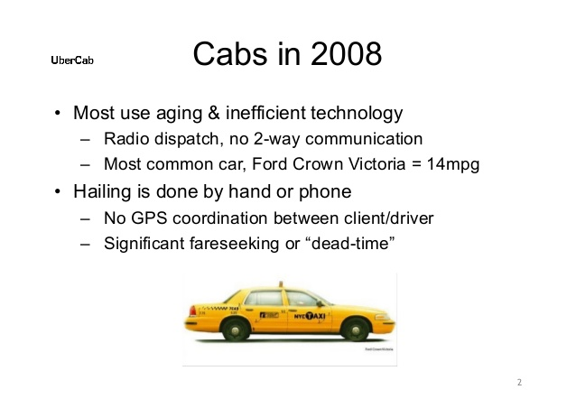
The solution directly addresses the issue
An on demand car hailing platform, linking passengers with available nearby drivers through a location based app service
Notes:
Traction.

Slide 11
Be creative in a structured way
1. Define the area of focus
2. Ideate (long list):
What are the problems/pain-points within the area of focus?
Who is it a problem/pain-point for?
3. Prioritize the problems (short list):
What problems are “big enough” and the most interesting to solve for? (your objectives matter)
Is there “willingness to pay” for getting it solved? (vitamin pill or painkiller?)
4. Come up with winning ideas:
How can the problem be solved in new or better ways?
Is the solution scalable?
5. Validate the solution:
What are the core assumptions we need to go out there and test?
Notes:
Traction.

Slide 12

Time allocation
45 minutes Breakout session #1
15 minutes Summary in plenary (3 teams)
45 minutes Breakout session #2
15 minutes Summary in plenary (3 teams)
Notes:
Traction.

Slide 13
Output after 45 minutes…
1. Define the area of focus
2. Ideate (long list):
What are the problems/pain-points within the area of focus?
Who is it a problem/pain-point for?
3. Prioritize the problems (short list):
What problems are “big enough” and the most interesting to solve for?
Is there “willingness to pay” for getting it solved? (vitamin pill or painkiller?)
4. Come up with winning ideas:
How can the problem be solved in new or better ways?
Is the solution scalable?
5. Validate the solution:
What are the core assumptions we need to go out there and test?
Clear problem definition
High level idea solving this problem

Slide 14
Example end result
An on demand car hailing platform, linking passengers with available nearby drivers through a location based app service
Core problem
Targeted solution
Notes:
Traction.

Slide 15
Why are we doing this exercise?
Practice putting the problem in focus (before the solution)
Introduce a simple framework for rapid structured team work
An opportunity to test who you work effectively with
Notes:
Traction.

Slide 16
Teams - Breakout session #1
In person
Team #1:
Ashish Patel
Jamie Pujara
Mikul Shah
Peng Chen
Team #2:
Daniel Nordberg
John K Juma
Simon Sondern
Tracy M Matia
Team #3:
David Lemayian
David Njonjo
Ore Alemede
Sonail Sanghrajka
Online
Team #4:
Alistair Gould
Fanen Acho
Katinka Harsanyi
Kennedy Mukuna
Michael A Denuh
Team #5:
Benson N Kariuki
Clementine V.
Thabani T Magubane
Dmitry Spitsberg
Team #6:
Mpho J Lebethe
Joyce Mbaya
Peter M Kihara
Ronald Kudoyi
Team #7:
Brian M Muriu
Bryan Waweru
Nwachukwu Ossai
Walela Masibo
Team #8:
James Macharia
Job Collins Dulo
Layla Li
Phillip Chele

Slide 17
Teams - Breakout session #2
In person
Team #1:
Ashish Patel
David Njonjo
John K Juma
Tracy M Matia
Team #2:
Daniel Nordberg
Jamie Pujara
Ore Alemede
Sonali Sanghrajka
Team #3:
Mikul Shah
Peng Chen
Simon Sondern
David Lemayian
Online
Team #4:
Brian M Muriu
Clementine V.
Job Collins Dulo
Joyce Mbaya
Kennedy Mukuna
Team #5:
Alistair Gould
James Macharia
Nwachukwu Ossai
Dmitry Spitsberg
Team #6:
Bryan Waweru
Katinka Harsanyi
Layla Li
Thabani T Magubane
Team #7:
Benson N Kariuki
Mpho J Lebethe
Michael A Denuh
Ronald Kudoyi
Team #8:
Fanen Acho
Peter M Kihara
Phillip Chele
Walela Masibo

